Slide 1
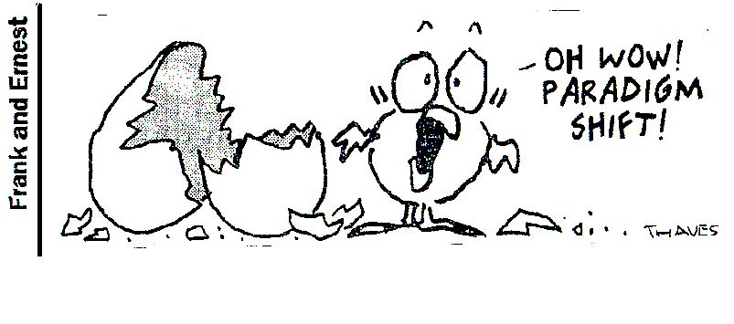
7 Habits of Highly Effective Teens
Paradigms and Principles

Slide 2

Top 10 All-Time Stupid Quotes
10) “There is no reason for any individual to have a computer in their home.” Kenneth Olsen, President and founder of Digital Equipment Corporation, 1977
9) “Airplanes are interesting toys but of no military use.” Marshal Ferdinand Foch, French military strategist and future World War I Commander, 1911
8) “[Man will never reach the moon] regardless of all future scientific advances.”—Dr. Lee de Forest, inventor of the audion tube and father of radio, February 1967
7) “[Television] won’t be able to hold on to any market it captures after the first six months. People will soon get tired of staring at a plywood box every night.”—Darryl Zanuck, head of 20th Century-Fox, 1946
6) “We don’t like their sound. Groups of guitars are on their way out.”—Decca Records rejecting the Beatles, 1962

Slide 3
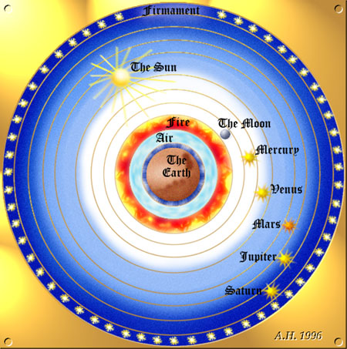
Top 10 All-Time Stupid Quotes
5) “For the majority of people, the use of tobacco has a beneficial effect.”—Dr. Ian Macdonald, LA Surgeon, November 1969
4) “The ‘telephone’ has too many shortcomings to be seriously considered as a means of communication. The devise is inherently of no value to us.”—Western Union internal memo, 1876
3) “The earth is the center of the universe.”—Ptolemy, Egypthian astronomer, 2nd century
2) “Nothing of importance happened today.” –King George III, July 4, 1776
1) “Everything that can be invented, has been invented.” –Charles Duell, Commissioner of Patents, 1899

Slide 4

What is a Paradigm?
What do the statements have in common?
They are all perceptions about the way things are
Another word for perceptions is paradigms (pair-a-dimes)
Paradigm is the way you see something, your point of view, or belief
Paradigms can be way off, so they create limitations
A paradigm for a struggling student could be, “I such at school”

Slide 5

Paradigms of Self
Are your paradigms of yourself keeping you back?
“Paradigm shifts” occur when you suddenly see things in a new way
What can you do if your paradigm of yourself is distorted?
“I can do it,” “I matter.”
Find someone who is encouraging and believes in you
At times you may need to go solo, use tools to build your self image (following chapters)

Slide 6
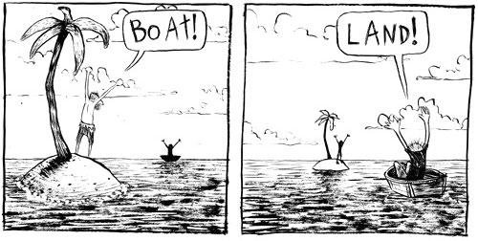
Paradigms of Others
Seeing things from another point of view can help us understand why other people act the way they do
We too often judge people without having all the facts

Slide 7

Paradigms of Life
Besides paradigms about ourselves and others, we
can have them about the world
What is the driving force in my life?
What do I spend my time thinking about?
Who or what is my obsession?
Whatever is most important to you will become your paradigm, your glasses, or life center
Popular paradigms for teens
Friends, Stuff, Boyfriend/Girlfriend, School, Parents, Sports/Hobbies, Heroes, Enemies, Self, Work

Slide 8

Friend-Centered
Friends are important, but should never become your center
Why?
If you base your identity on having friends, being accepted, and being popular, you may compromise your standards

Slide 9
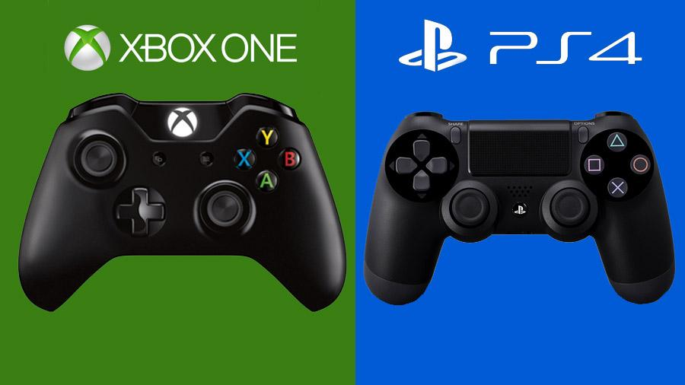
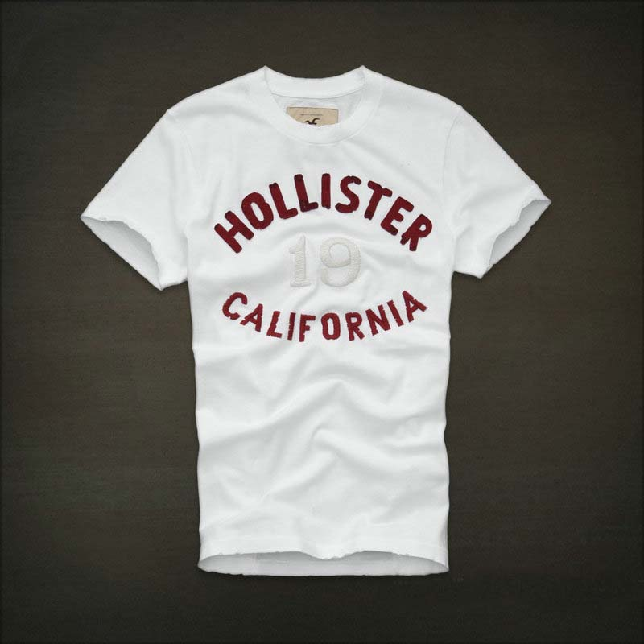
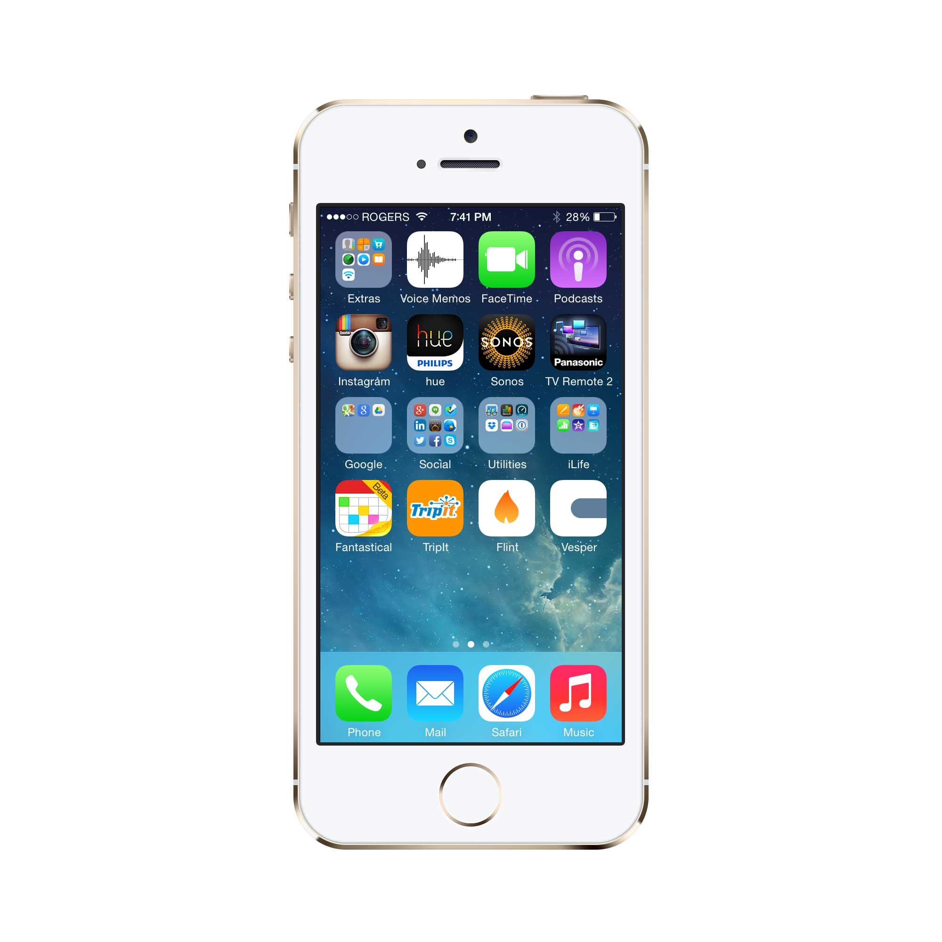
Stuff-Centered
Sometimes we see the world
through the lens of possessions
or ‘stuff’
Have to have the fastest car, the nicest clothes, the lates phone, best hairstyle, & titles and accomplishments, such as head cheerleader, MVP…the many things that are supposed to bring us happiness
Nothing wrong with accomplishing & enjoying our stuff, but they should never be the center of our lives
Confidence comes from within, not without: the quality of our hearts, not the quality of our things

Slide 10

Boyfriend/Girlfriend-Centered
It is attractive to be your own person, have your own strengths, independent of others
When someone centers their life on a boyfriend or girlfriend:
Tasha’s Actions Bradley’s Reaction
Makes a rude comment “My day is ruined.”
Flirts with Bradley’s best friend “I’ve been betrayed. I hate my friend.”
“I think we should date other “My life is over. You don’t love me
people.” anymore.”

Slide 11
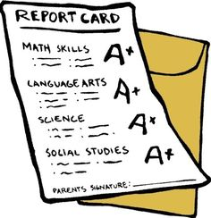

School-Centered
Centering one’s life on school is more common than you might think
Education is vital to our future, and should be a top priority
School-centered teens become so obsessed with getting good grades that they forget that the real purpose of school is to learn

Slide 12

Parent Centered
Parents can be your greatest source of love and guidance
Should be respected and honored
But, don’t center your life on your parents and living to please them above everything else

Slide 13

Other Possible Centers
Sports/Hobbies
Build identity around being a great athlete—what happens when a career ending injury happens?
Hero-Centered
If you build your life around a movie star or musician, famous athlete or powerful politicians, what happens if they die, or do something stupid?
Enemy-Centered
Build your life around hating a group, person, or an idea
Work-Centered
Workaholism is usually driven by a compulsive need to have more stuff, like money, cars, status, or recognition
Self-Centered
Thinking the world revolves around you and your problems—oblivious to the walking wounded around you

Slide 14
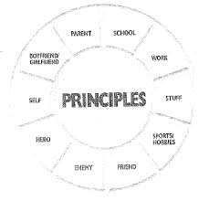
Principle-Centered —The Real Thing
A natural law or principle
Aren’t religious, aren’t American or Chinese, aren’t yours or mine
Apply equal to everyone, rich or poor, king or peasant, male or female
Can’t be bought or sold
If you live by them, you will excel
If you break them, you will fail

Slide 15


Principal-Centered—The Real Thing
Examples:
Honesty, Service, Love, Hard Work, Respect, Gratitude, Moderation, Fairness, Integrity, Loyalty, Responsibility, etc.
Principal of Hard Work
Have to pay the price to get there

Slide 16

Principles Never Fail
Takes faith to live by principles, especially when you see people close to you get ahead in life by lying, cheating, indulging, manipulating, and serving only themselves
Breaking principles always catches up to you in the end
For example, take the principal of Honesty
If you’re a big liar, you might be able to get by for a while, even a few years—but it’s hard to find a liar who achieved success over the long haul
They don’t talk behind your back, don’t get up and move on, don’t suffer career-ending injuries, don’t play favorites
It is simply the most stable, unshakable foundation you can build on—something we all need!

Slide 17

Put Principles First
If you live by the principles of service, respect and love, for instance, you’ll likely pick up more friends and be a more stable boyfriend or girlfriend
Key to becoming a person of character
In 7 Habits, you’ll discover that each Habit is based upon a basic principle or two
That’s where they get their power from

